Slide 1
CSI3344 Distributed Systems
Lecture 2:
Client-Server Architecture
Architectural Styles
General Client-Server Model
Client-Server Interaction
Client-Server Organizations
  Major Points
  Reading Guide
Distributed Systems
CSI3344

Slide 2
CSI3344 Distributed Systems
Objectives
  Be familiar with the general Client-Server architectures;
  Describe the interactions between clients and servers;
  Give examples of client-server interactions in Distributed Systems;
  Be familiar with features and functionalities of client-server organisations.
CSI3344
Distributed Systems

Slide 3
Architectural Styles (1/6)
Software Architecture
  How the various software components are organized and how they interact
System Architecture
  The final instantiation of a software architecture (of many choices)
Styles of DS architectures
  Client-Server architecture
  Layered architectures
  Object-based architectures
  Data-centered architectures
  Event-based architectures, etc.
CSI3344
Distributed Systems
Notes:
Other architectural styles includes:
Component-based;
Domain-driven;
Message-bus;
Service-oriented; etc.

Slide 4
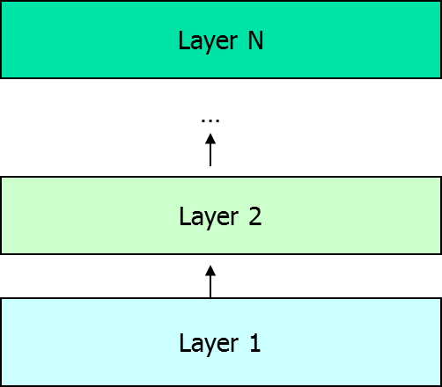

Architectural Styles (2/6)
The layered architectural style
  Layered style is used for client-server system
  Control generally flows from layer to layer:
  Requests go down
  the hierarchy
  whereas the results
  flow upward.
CSI3344
Distributed Systems

Slide 5
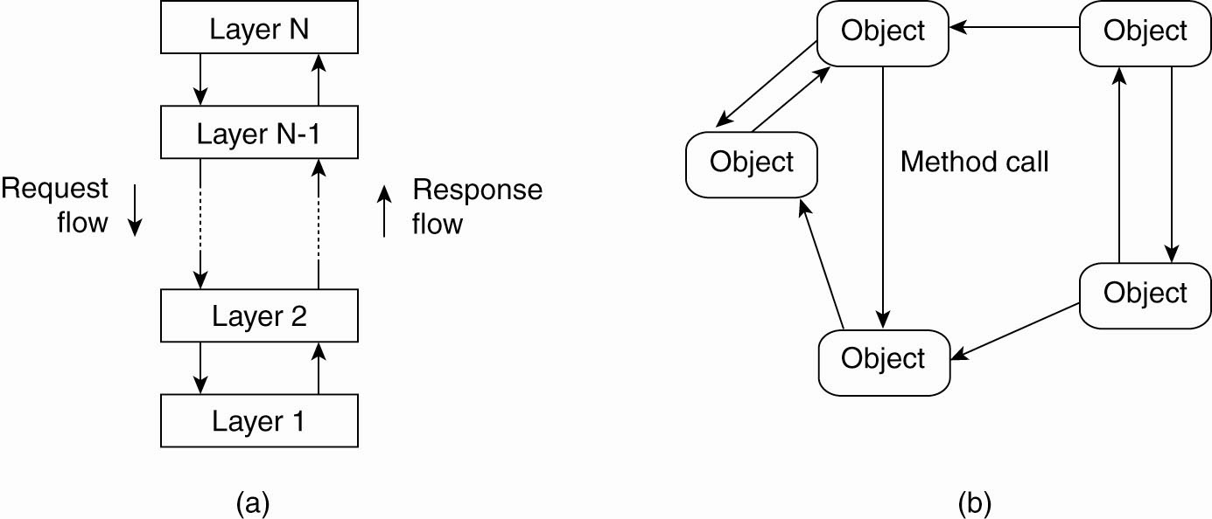
Architectural Styles (3/6)
The object-based architectural style
  Object-based style for distributed object systems.
  Each object corresponds to a component, and these components are connected through a (remote) procedure call.
CSI3344
Distributed Systems

Slide 6
Architectural Styles (4/6)
Data-centered architectural style
  Processes communicate through a common data repository.
  Rely on a shared distributed file system
  Virtually, all communication takes place through files
  Example: Web based distributed system
    Processes communicate through the use of shared Web-based data services.
CSI3344
Distributed Systems

Slide 7
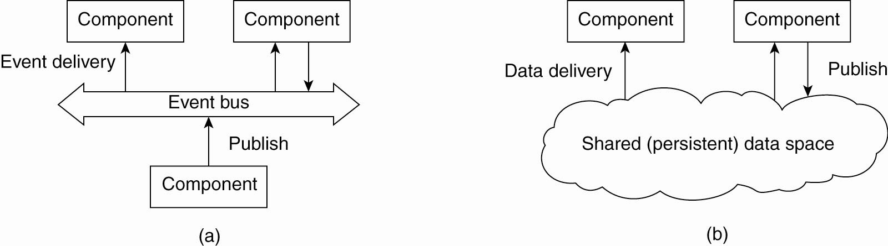
Architectural Styles (5/6)
The event-based architectural style
  Publish/subscribe system: processes publish events after which the middleware ensures that only those processes that subscribed those events will receive them
CSI3344
Distributed Systems
Notes:
Event: a data item represented by (attribute, value) pair. E.g., health monitoring system, where many sensors are installed around a room to monitor moving activities etc of aged people. In such a case, a person come in the room (i.e., open door), or switch on the light, or turn on tape, or leaves the room, etc, are all events. As they change of the value of the monitoring system values. See p597 and p604 for detailed definitions.

Slide 8
Architectural Styles (6/6)
The shared data-space architectural style
  Combination of event-based architecture and data-centered architecture
  Used in distributed file systems and Web based distributed system: Processes communicate through the use of shared Web-based data services.
CSI3344
Distributed Systems

Slide 9
2.1 General Client-Server Model (1/9)
General model
Nothing agreed but a loose structure, including
- clients that require services from servers, and
- servers that provide services to clients who require them.
invocation
Client
result
Server
Client
CSI3344
Distributed Systems
Notes:
Example: www

Slide 10
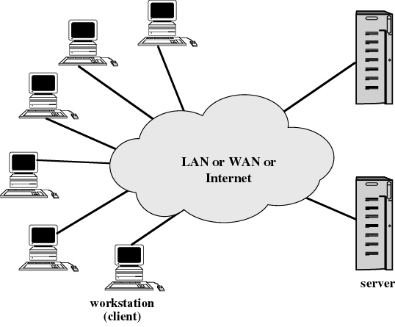
2.1 General Client-Server Model (2/9)
Environment
Clients and servers are networked for passing messages.
CSI3344
Distributed Systems

Slide 11
2.1 General Client-Server Model (3/9)
Client
  A client (program) is a process that requests a service from server by sending a request and subsequently waiting for the server’s reply.
  Client machines are generally single-user PCs or workstations that provide a highly user-friendly interface to the end user.
  Client and server may have different platforms and operating systems, but they share the same communication protocols and support the same applications.
CSI3344
Distributed Systems

Slide 12
2.1 General Client-Server Model (4/9)
Server
  A server is a process implementing a specific service (eg, a file system or database service).
  A server may enable many clients to share access to the same database and enable the use of a high-performance computer system to manage the database.
  Communication between clients and servers is implemented by means of communication protocols, such as TCP/IP, etc.
CSI3344
Distributed Systems

Slide 13
2.1 General Client-Server Model (5/9)
Client-Server Boundary
  There is no clear distinction between a client and a server.
Client
invocation
invocation
Server
result
Server
result
Server1 = client
Server2 = server
Client
Client = client
Server1 = server
Key:
Process:
Computer:
CSI3344
Distributed Systems
Notes:
Querying a web server, which could then query a Mysql or Oracle database before returning the content of a page
Web server is a client of the database server
A search engine, as well as serving search requests from clients, crawls other websites to keep its information current.
Search engine is both a server and a client for other web servers.

Slide 14
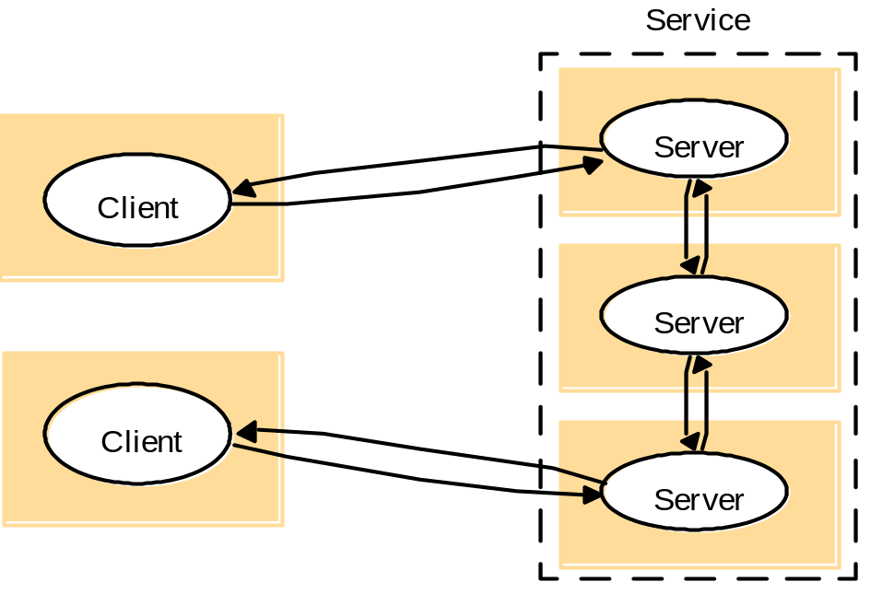
2.1 General Client-Server Model (6/9)
A service provided
by multiple servers
Services may be
implemented as several
server processes in
separate host computers.
Example: Cluster based
Web servers and apps
such as Google, parallel
databases Oracle
CSI3344
Distributed Systems
Notes:
This topology is extremely common. A web site like google serves approximately 100M searches a day.
It is obviously simply not feasible to serve them from a single server.
Google uses clusters containing 10’s of thousands of machines offering equivalent services, and you are redirected (via DNS and other means) to one of them. Can also be redirected at protocol or application level.
Similar techniques can be used for Oracle databases, that are replicated over many servers to offer redundancy and performance

Slide 15
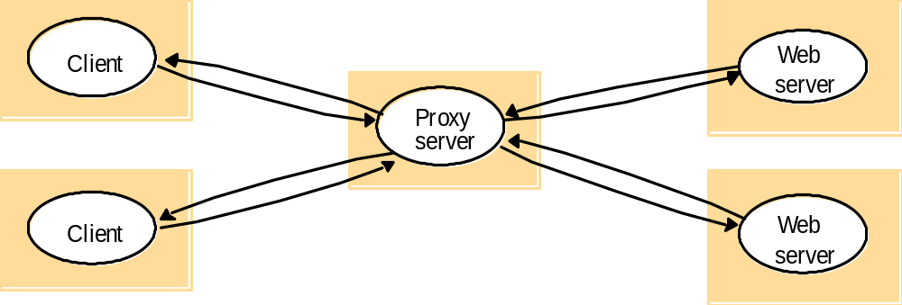
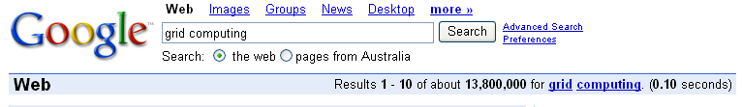
2.1 General Client-Server Model (7/9)
Proxy servers (replication transparency) and caches: Web proxy server
A cache is a store of recently used data.
CSI3344
Distributed Systems
Notes:
Web proxy servers can operate at client level, at ISP level and at edge/gateway levels to improve performance and reduce communication costs for frequently accessed data.
Caching can even be used for dynamic data (such as a google search). This reduces the load on the web servers and improves the performance for end users by reducing the time taken for a dynamic request. Google uses this technique extensively! When serving 100M requests/day this saves resources.

Slide 16
2.1 General Client-Server Model (8/9)
Application Layering in client-server model
  User-interface level
  The user-interface level contains all that is necessary to directly interface the user, and thus is implemented in clients.
  Processing level
  It contains client-server applications that roughly consist of
  - a part interacting with users;
  - another part operating on database or file systems; and
  - a middle part containing the core functionality of an application.
  Data level
  It contains the actual data and the programs that maintain the data, on which the applications operate.
CSI3344
Distributed Systems

Slide 17
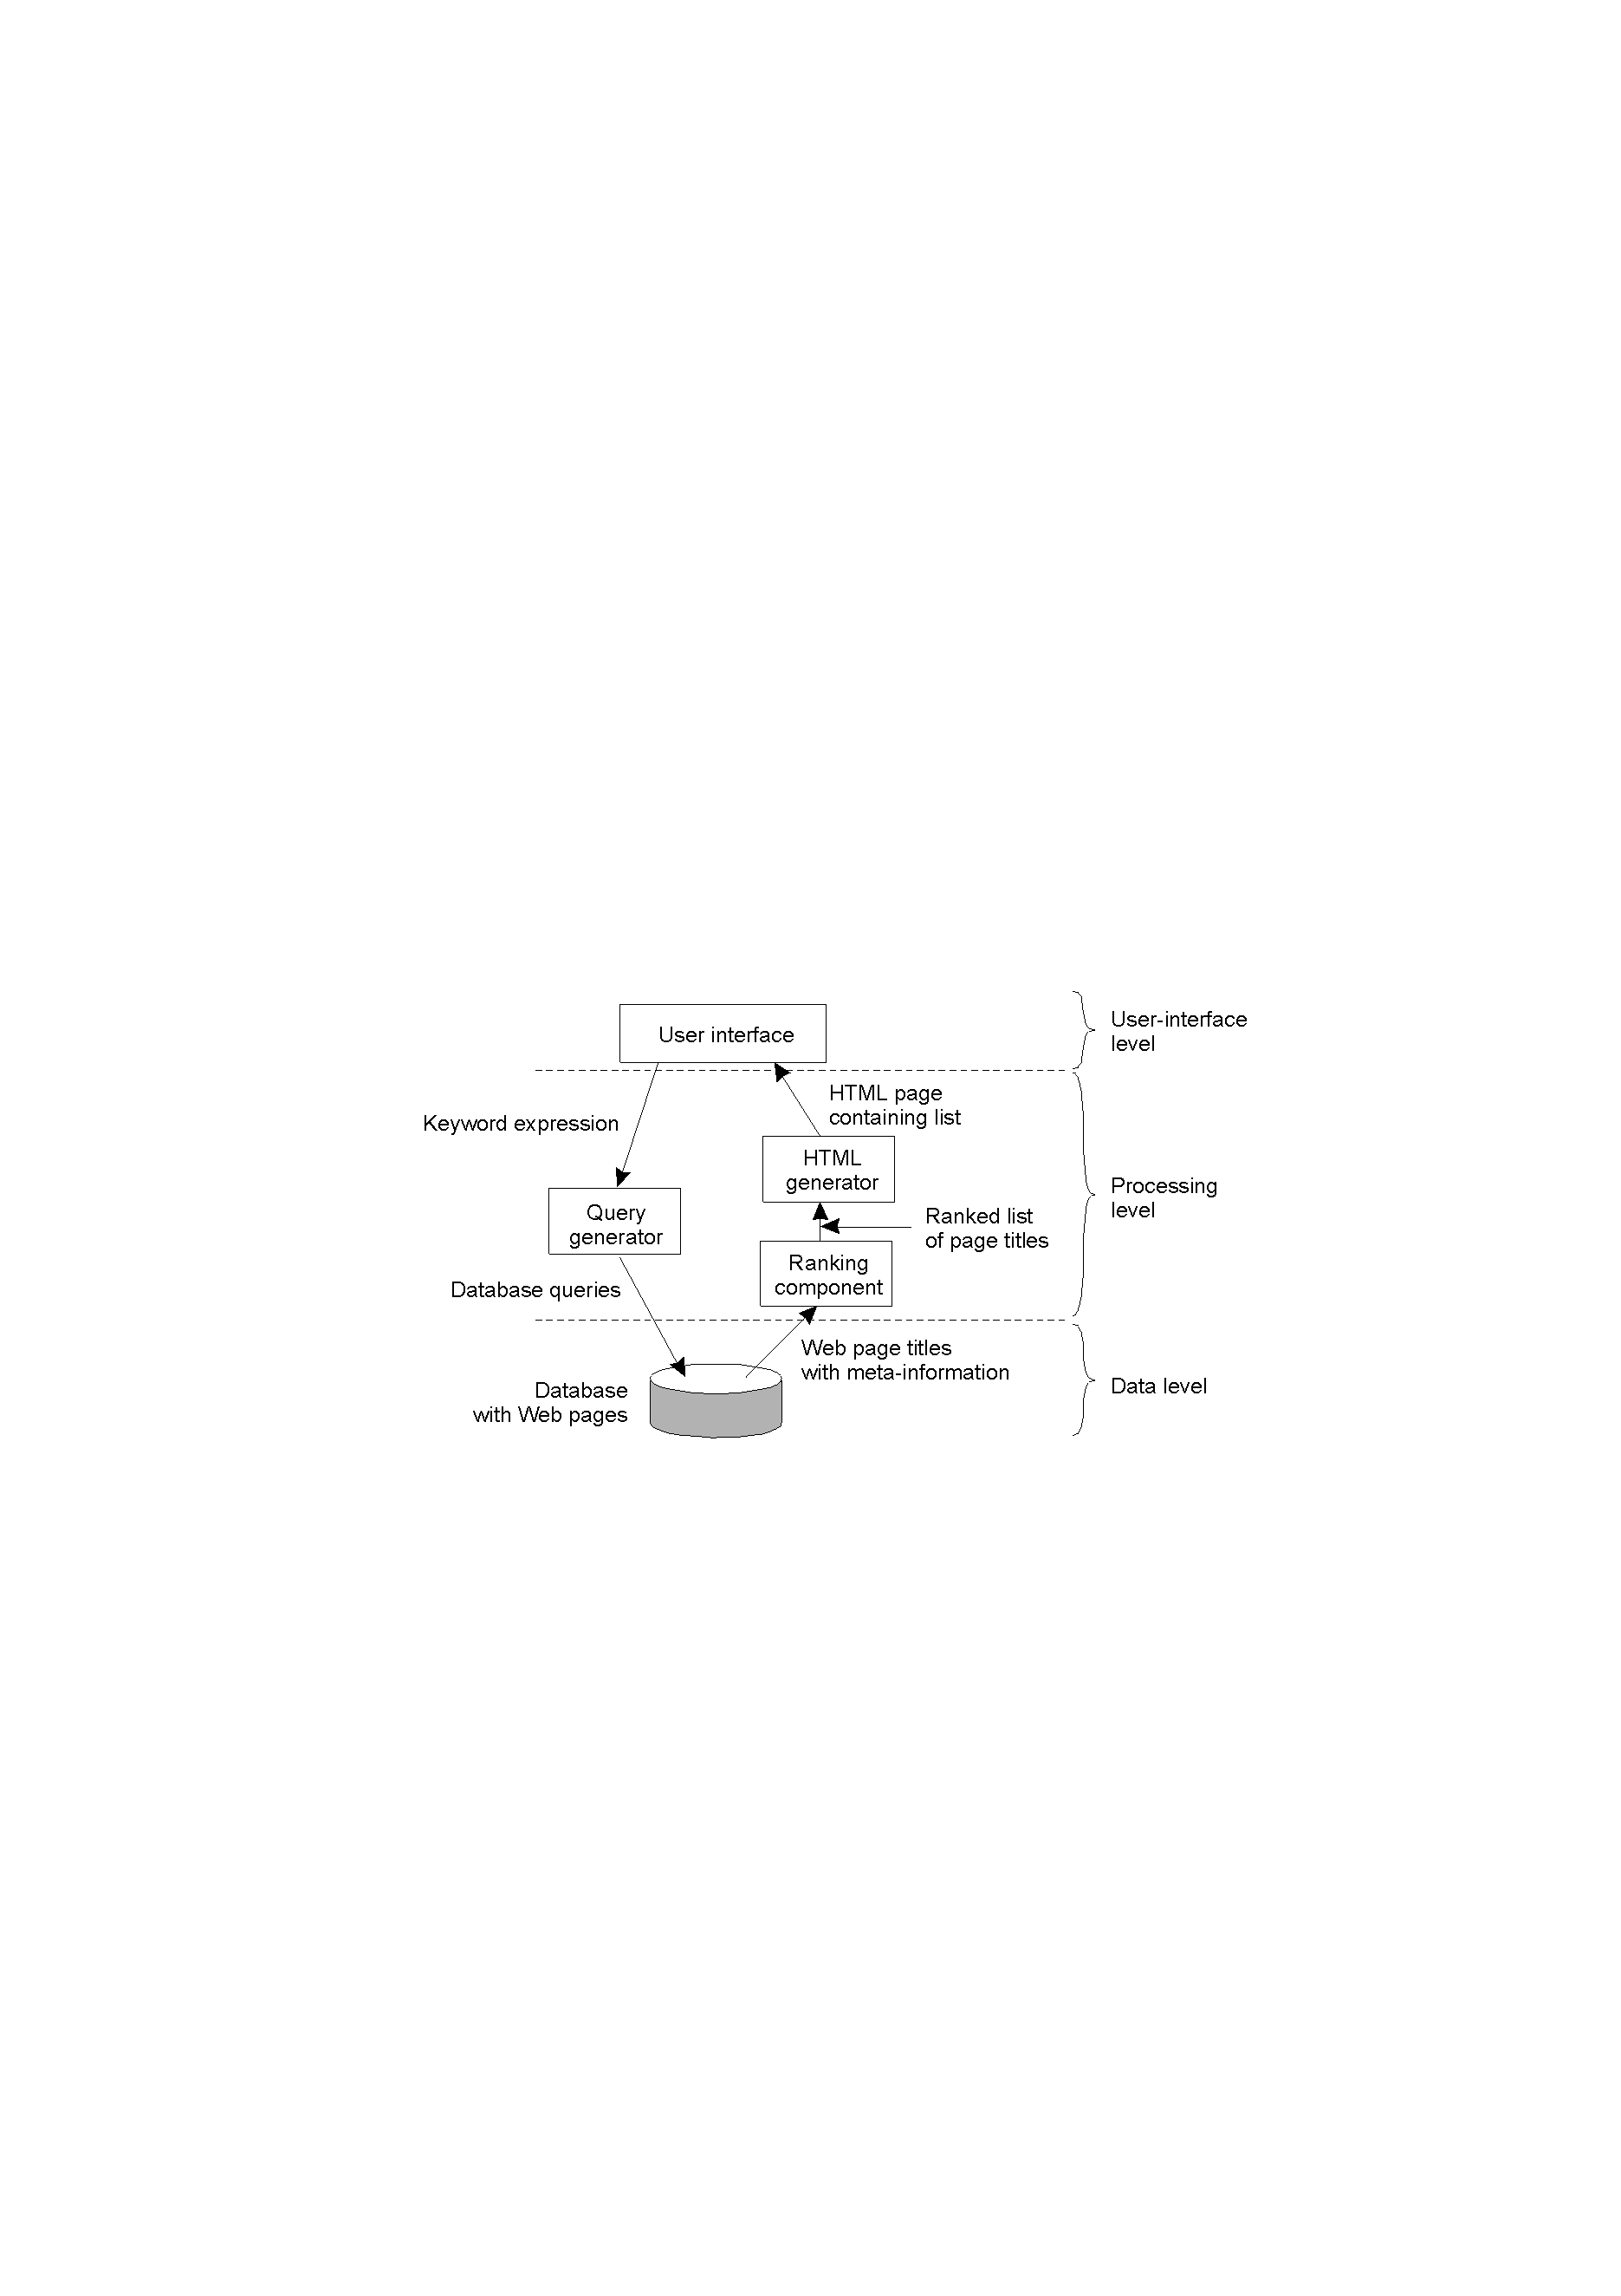
2.1 General Client-Server Model (9/9)
Application Layering
  Example: The simplified organization of an Internet search engine into three different layers
CSI3344
Distributed Systems
Notes:
Example: google

Slide 18
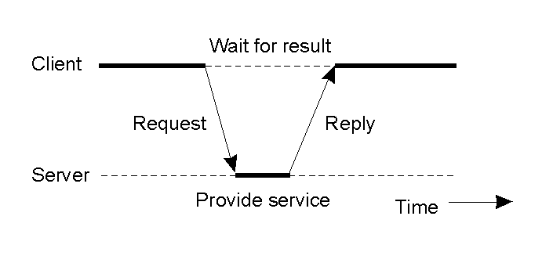
2.2 Client-Server Interactions (1/6)
Interaction Procedure
  The client-server interaction is known as request-reply behaviour.
CSI3344
Distributed Systems

Slide 19
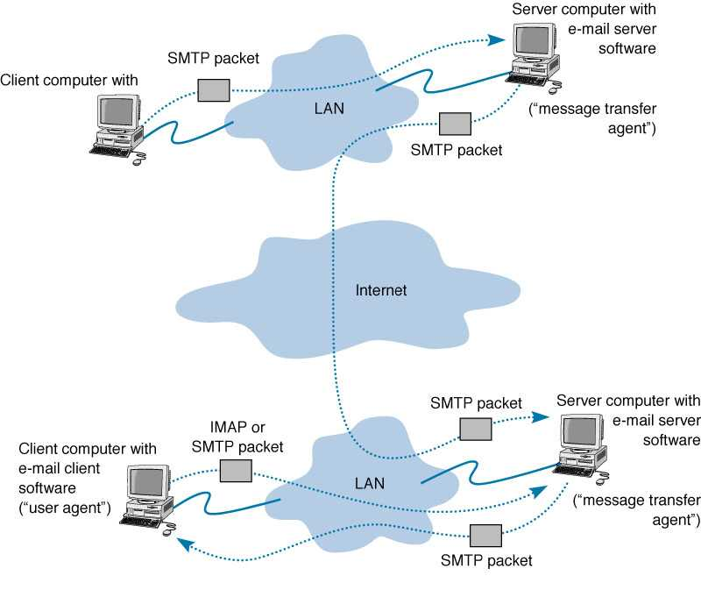

2.2 Client-Server Interactions (2/6)
Example 1: Electronic Mail
CSI3344
Distributed Systems
Notes:
SMTP (Simple Mail Transport Protocols)
IMAP (Internet Message Access Protocol)

Slide 20
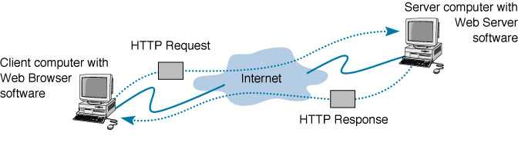
2.2 Client-Server Interactions (3/6)
Example 2: World Wide Web
CSI3344
Distributed Systems
Notes:
HTTP (HyperText Transfer Protocols)

Slide 21
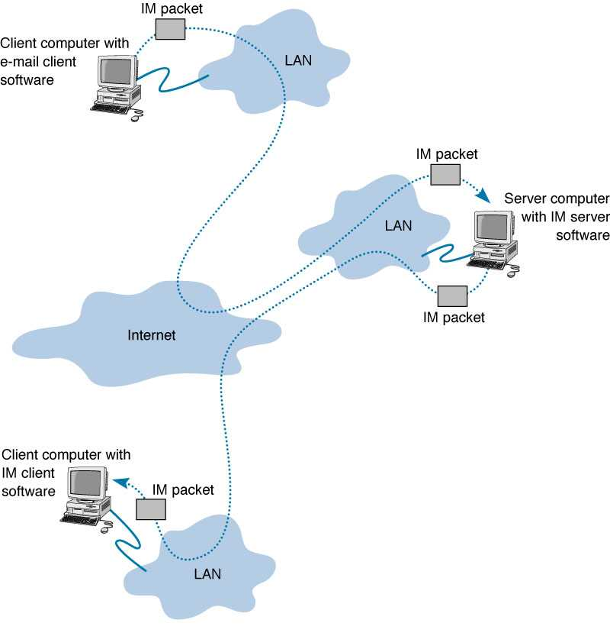

2.2 Client-Server Interactions (4/6)
Example 3: Instant Messaging (IM)
  IM allows real-time messages to be exchanged.
CSI3344
Distributed Systems

Slide 22
2.2 Client-Server Interactions (5/6)
Example 4: Database Application (1)
  System Functionality
    The server is a database server.
    Interaction between client and server is in the form of transactions.
    The client makes a database request and receives a database response.
    Server is responsible for maintaining the database.
CSI3344
Distributed Systems

Slide 23
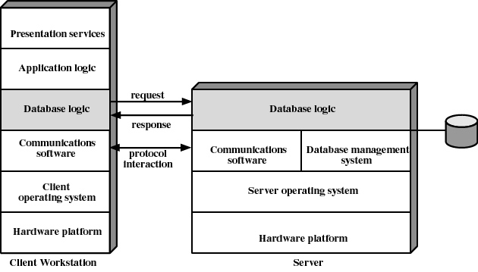
2.2 Client-Server Interactions (6/6)
Example 4: Database Application (2)
  System Architecture
CSI3344
Distributed Systems

Slide 24
2.3 Client-Server Organizations (1/9)
2.3.1 Vertical Distribution
Places logically different components on different machines.
Vertical distribution can be classified into three categories:
  Two-tiered architectures
  Three-tiered architectures
  Multi-tiered architectures
CSI3344
Distributed Systems

Slide 25











2.3 Client-Server Organizations (2/9)
Two-tier model (classic)
Three-tier (when the server becomes a client)
Multi-tier (cascade model)
client
server
client
Server/client
server
server
client
Server/client
Server/client
server
CSI3344
Distributed Systems

Slide 26


2.3 Client-Server Organizations (3/9)
- Two-tiered architectures (1)
Application software distributed among two types of machines - client and server - that directly communicate with each other.
  E.g., client/single server configuration
client
server
CSI3344
Distributed Systems
Notes:
The simplest organization is to have only two types of machines:
A client machine containing only the programs implementing (part of) the user-interface level
A server machine containing the rest,
the programs implementing the processing and data level

Slide 27
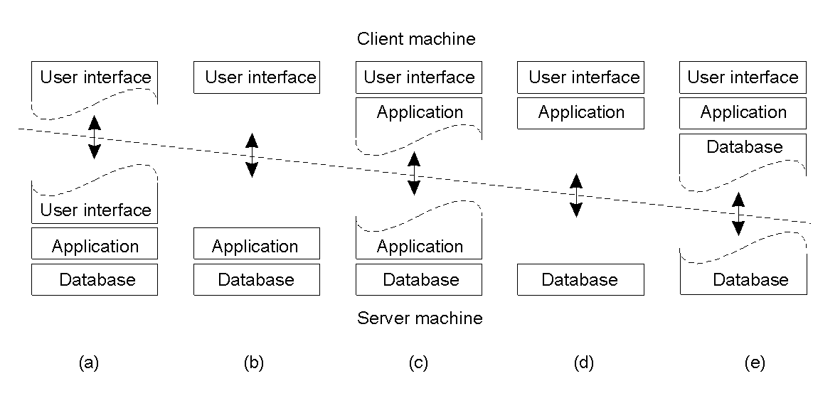
2.3 Client-Server Organizations (4/9)
- Two-tiered architectures (2)
  - Architectural Summary
CSI3344
Distributed Systems

Slide 28
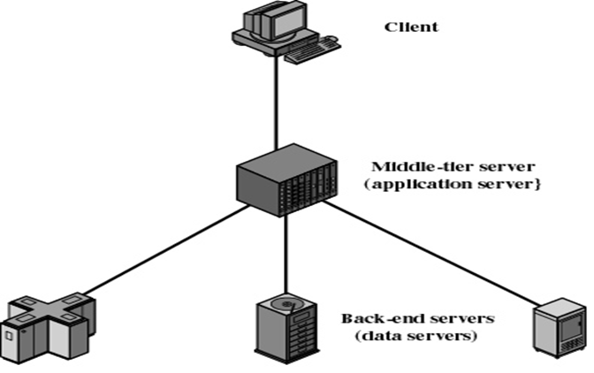
2.3 Client-Server Organizations (5/9)
Three-tiered architectures (1/2)
  -- Each layer on separate machine
  Application software distributed
  among three types of machines
    User machine
      thin client
    Middle-tier server
      Gateway
      Convert protocols
      Merge/integrate results from different data sources
    Backend server
CSI3344
Distributed Systems

Slide 29
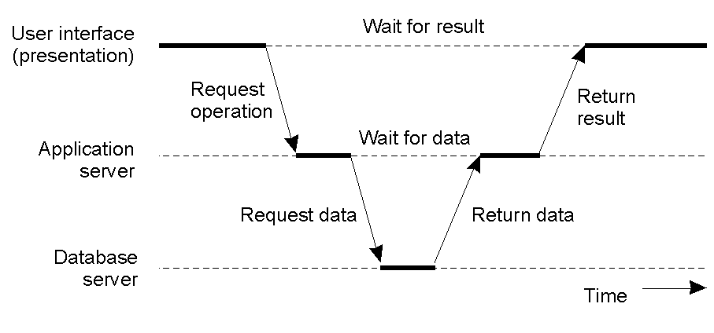
2.3 Client-Server Organizations (6/9)
Three-tiered architectures (2/2)
  Interaction
CSI3344
Distributed Systems

Slide 30
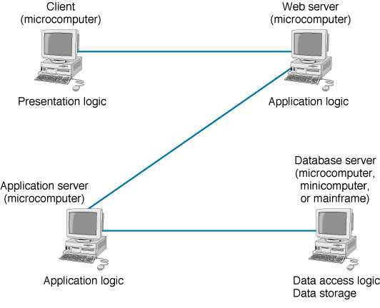
2.3 Client-Server Organizations (7/9)
Multi-tiered architectures
  In an N-tier architecture more than three sets of computers are used.
CSI3344
Distributed Systems

Slide 31
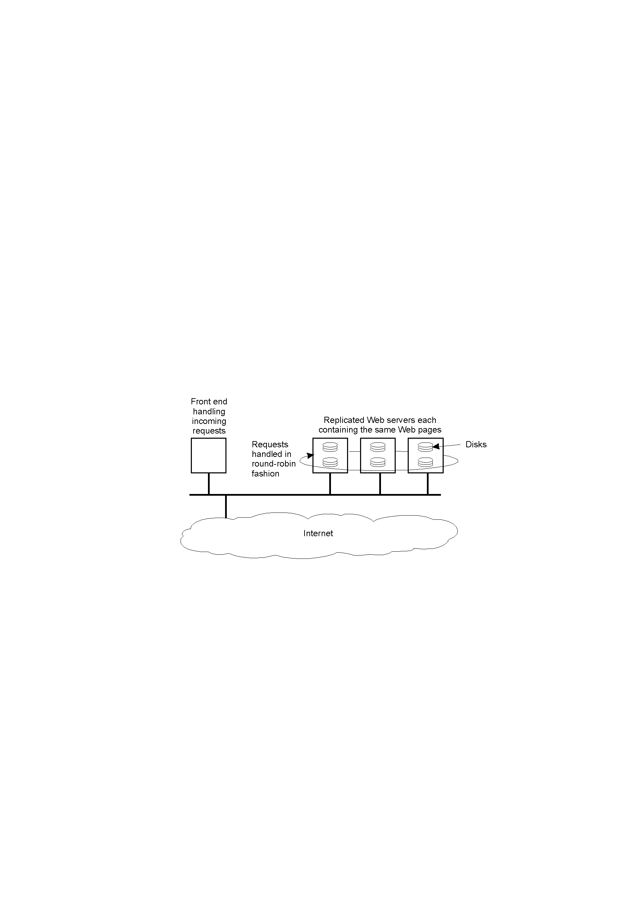
2.3 Client-Server Organizations (8/9)
2.3.2 Horizontal Distribution
A client or server may be split up into logically equivalent parts, each operates on its own share of the complete data set, thus balances
the load.
Also called
the modern
architecture.
CSI3344
Distributed Systems

Slide 32
2.3 Client-Server Organizations (9/9)
2.3.3 Other architectures (read text p43-54)
  Peer-to-Peer (P2P) Architectures: computers of same standard, neither is a server, nor a client
    Structured P2P;
    Unstructured P2P;
    Hybrid P2P
  Super-peers
  Edge-Server Systems
  Collaborative Distributed Systems, etc.
CSI3344
Distributed Systems
Notes:
Super-peer: a node in a peer-to-peer network that operates both as a server to a set of clients, and as an equal in
a network of super-peers.
An edge server resides on the "edge" between two networks, typically a private network and the Internet. Edge servers can serve different purposes depending on the context of the functionality in question. Some examples:
Security Context: usually a firewall, router or similar device
Application Context: a web load balancing server
Mail Context: some kind of hub server that forwards mail on to internal servers
Usually an edge server has some kind of gateway responsibility for the internal/private network.
Distributed collaborative system architecture: one facilitates and coordinates collaboration among multiple users who jointly fulfill common tasks over internets/networks.

Slide 33
Major Points
Important styles of DS architectures
Application layering
Client-server interaction procedure
Classes of two-tiered architectures
Features and interaction of three-tiered architecture
CSI3344
Distributed Systems

Slide 34
Reading Guide
DSPP
  Chapter 2: Section 2.1, 2.2
  Chapter 3: Section 3.3, 3.4
Additional reading (optional)
  DSCD
    Chapter 2: Sections 2.2.2, 2.2.3
  DSPP
    Chapter 2: Section 2.3
  Networking in the Internet Age by A Dennis, Wiley, 2002; Chapter 2: Application Layers
CSI3344
Distributed Systems

